Slide 1

Object Oriented Programming

Slide 2
Object Oriented Programming (using C++)
WEEK 3

Slide 3
Running for help at the first sight of a problem is the biggest obstacle for one to become a good programmer

Slide 4
Procedural Languages
C, Pascal, FORTRAN, and similar languages are procedural languages. That is, each statement in the language tells the computer to do something: Get some input, add these numbers, divide by six, display that output.
A program in a procedural language is a list of instructions.
For very small programs, no other organizing principle (often called a paradigm) is needed.
The programmer creates the list of instructions, and the computer carries them out
NO NEED TO CRAM , BUT UNDERSTAND

Slide 5
Division into Functions
When programs become larger, a single list of instructions becomes unwieldy. Few programmers can comprehend a program of more than a few hundred statements unless it is broken down into smaller units. For this reason the function was adopted as a way to make programs more comprehensible to their human creators. (The term function is used in C++ and C. In other languages the same concept may be referred to as a subroutine, a subprogram, or a procedure.)
NO NEED TO CRAM , BUT UNDERSTAND

Slide 6
The idea of breaking a program into functions can be further extended by grouping a number of functions together into a larger entity called a module (which is often a file), but the principle is similar: a grouping of components that execute lists of instructions.

Slide 7
Problems with Structured Programming
Modifiability and Reusability
Data Security
Code Organization
Communication
NO NEED TO CRAM , BUT UNDERSTAND

Slide 8
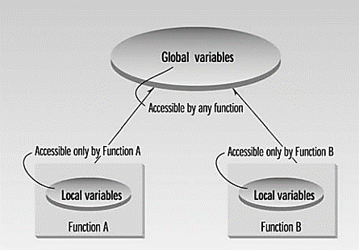

Slide 9
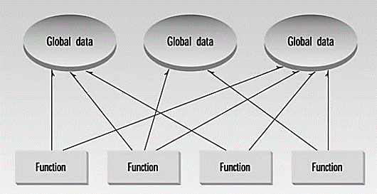
This large number of connections causes problems in several ways. First, it makes a program’s structure difficult to conceptualize. Second, it makes the program difficult to modify. A change made in a global data item may necessitate rewriting all the functions that access that item.
In a large program, there are many functions and many global data items. The problem with the procedural paradigm is that this leads to an even larger number of potential connections between functions and data.

Slide 10
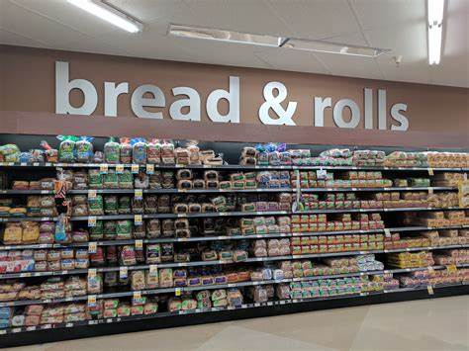
Everything is related to everything else, so a modification anywhere has far-reaching, and often unintended, consequences.
For example, in our inventory program, someone may decide that the product codes for the inventory items should be changed from 5 digits to 12 digits. This may necessitate a change from a short to a long data type.
Now all the functions that operate on the data must be modified to deal with a long instead of a short. It’s similar to what happens when your local supermarket moves the bread from aisle 4 to aisle 7. Everyone who patronizes the supermarket must then figure out where the bread has gone, and adjust their shopping habits accordingly.

Slide 11
Real-World Modeling
The second—and more important—problem with the procedural paradigm is that its arrangement of separate data and functions does a poor job of modeling things in the real world.
In the physical world we deal with objects such as people and cars. Such objects aren’t like data and they aren’t like functions. Complex real-world objects have both attributes and behavior.

Slide 12
Attributes
Examples of attributes (sometimes called characteristics) are, for people, eye color and job title; and, for cars, horsepower and number of doors. As it turns out, attributes in the real world are equivalent to data in a program: they have a certain specific values, such as blue (for eye color) or four (for the number of doors).

Slide 13
Behavior
Behavior is something a real-world object does in response to some stimulus. If you ask your friend for a help, he/she will generally say yes or no. If you apply the brakes in a car, it will generally stop. Saying something and stopping are examples of behavior.
Behavior is like a function: you call a function to do something (display the inventory, for example) and it does it.
So neither data nor functions, by themselves, model real-world objects effectively

Slide 14
The Object-Oriented Approach
The fundamental idea behind object-oriented languages is to combine into a single unit both data and the functions that operate on that data. Such a unit is called an object.

Slide 15
An object’s functions, called member functions in C++, typically provide the only way to access its data. If you want to read a data item in an object, you call a member function in the object. It will access the data and return the value to you. You can’t access the data directly.
The data is hidden, so it is safe from accidental alteration. Data and its functions are said to be encapsulated into a single entity.
Data encapsulation and data hiding are key terms in the description of object-oriented languages
Don’t worry about terms that we have not dived deep into yet.

Slide 16
If you want to modify the data in an object, you know exactly what functions interact with it: the member functions in the object. No other functions can access the data. This simplifies writing, debugging, and maintaining the program.
A C++ program typically consists of a number of objects, which communicate with each other by calling one another’s member functions.
Don’t worry about terms that we have not dived deep into yet.

Slide 17
We should mention that what are called member functions in C++ are called methods in some other object-oriented (OO) languages (such as Smalltalk, one of the first OO languages).
Also, data items are referred to as attributes or instance variables.
Calling an object’s member function is referred to as sending a message to the object.
These terms are not official C++ terminology, but they are used with increasing frequency, especially in object-oriented design.

Slide 18
Don’t worry about terms that we have not dived deep into yet.
C++ allows you to create your own types. These custom types can have operators and can be converted to other types; indeed, they can be used like built-in types with the behavior that you define.
This facility uses a language feature called classes. The advantage of being able to define your own types is that you can encapsulate data in objects of your chosen type, and use the type to manage the lifetime of that data.
You can also define the actions that can be performed on that data. In other words, you are able to define custom types that have state and behavior, which is the basis of object-orientated programming.

Slide 19
Message passing
Message passing in Object-Oriented Programming (OOP) refers to the way objects communicate with each other by sending and receiving information. In C++, this concept is achieved through invoking member functions of an object, which are essentially messages sent to the object. Each message corresponds to a specific function that the object can execute.
Here's how message passing works in C++:
Defining a Class: First, you define a class with its member functions (methods). These functions represent the actions that the objects of the class can perform.
Creating Objects: Next, you create objects of the class. Each object is an instance of the class and can perform the actions defined by its class's methods.
Invoking Methods: To pass a message, you call a method on an object. The method receives parameters, if any, and executes the corresponding block of code. The result of the method execution could be a value returned by the method or the state change of the object.

Slide 20
class Car {
public:
void startEngine() {
// Code to start the engine
}
};
int main() {
Car myCar;
myCar.startEngine(); // Passing a message to start the car's engine
return 0;
}

Slide 21
Code already shared on gcr

Slide 22

Practice task
For the following scenarios try to think and identify :
what could be possible classes ?
What could be attributes of the objects ? (data)
What could be the behavior of that objects ? (functions)

Slide 23

Example 1
A hospital is developing a new system to manage and track the analysis done by patients, how might you design the classes and objects for this system? Consider the following scenario:
A hospital wishes to improve its patient care management by implementing a system that records the medical analyses performed on patients. This system should be able to track which doctors requested the analyses, which patients underwent the analyses, and the results of these analyses. The system should also allow for easy retrieval of patient analysis records and should ensure data integrity and consistency.
You can make assumptions

Slide 24

Example 2
A fleet management company is tasked with overseeing the operation of a large number of electric vehicles. The goal is to ensure that each vehicle is running efficiently, the battery health is monitored, and maintenance is scheduled and performed on time. The system needs to track the current location of each vehicle, manage a list of all vehicles, and handle maintenance tasks.
You can make assumptions

Slide 25


